Slide 1
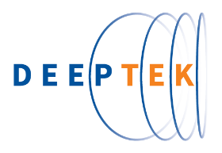

AI Powered Radiology For Efficient Pandemic Response
www.DeepTek.ai
© DeepTek Inc.

Slide 2

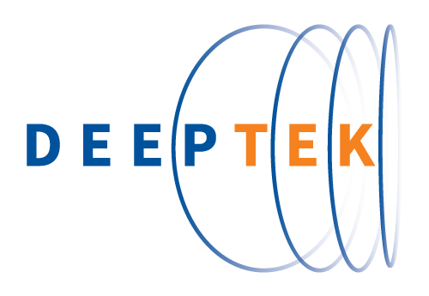
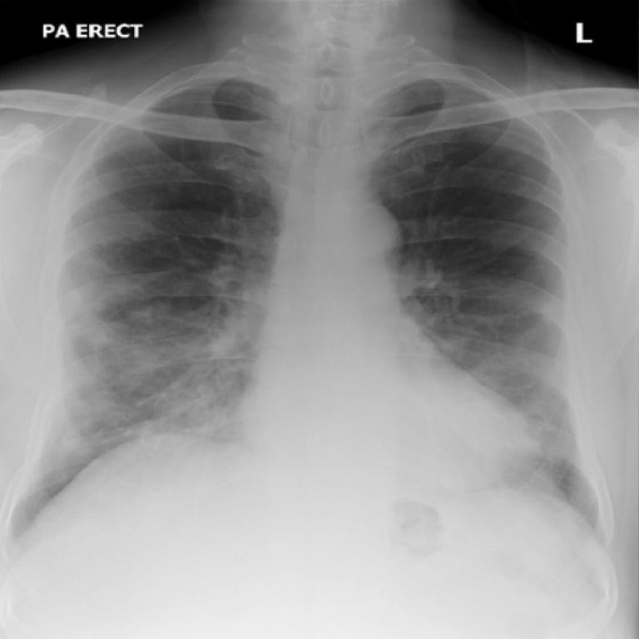
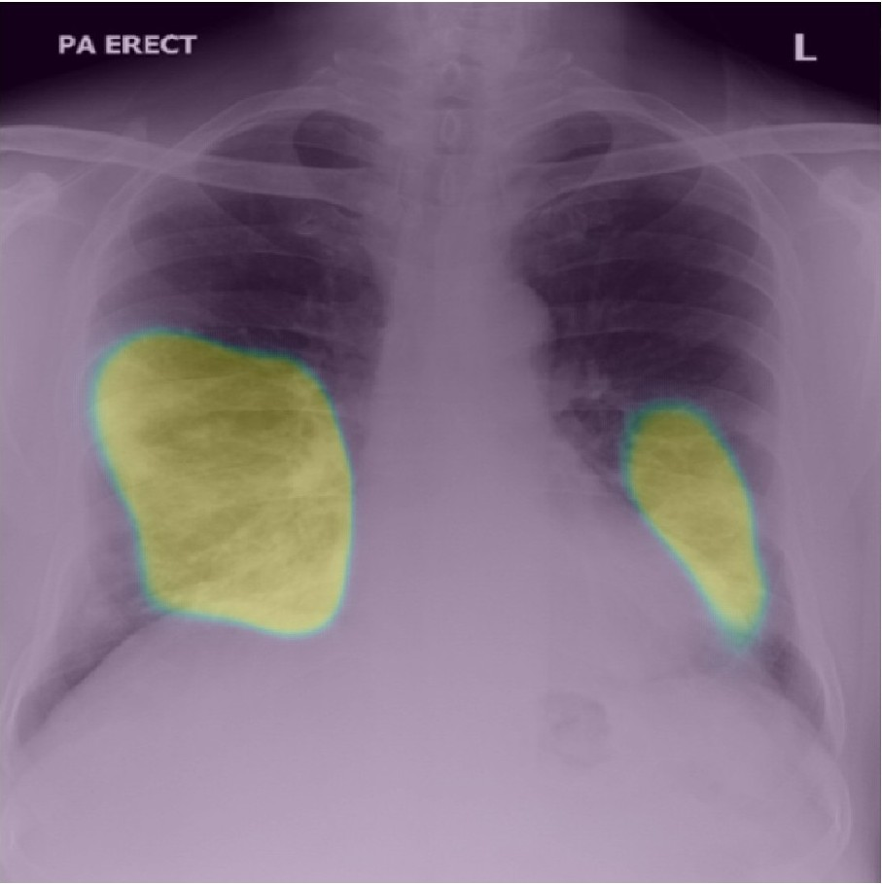


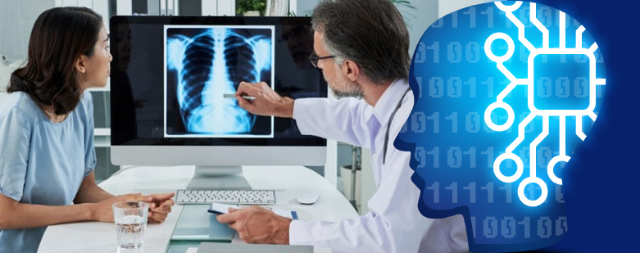
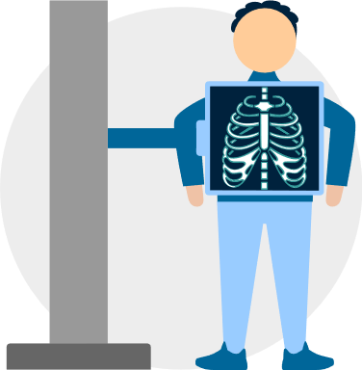
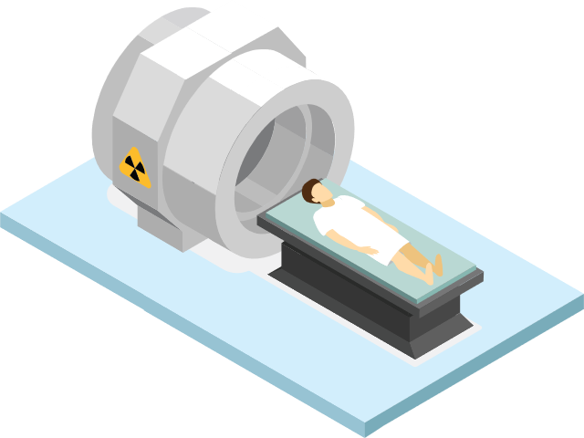
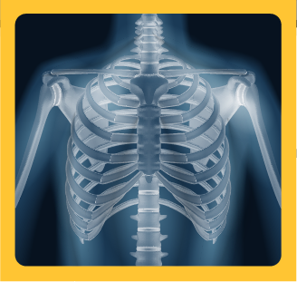
Medical Imaging AI for Efficient Pandemic Response: COVID, TB Like Infectious Diseases
Chest X Rays / CT Scans
AI Engine
Expert In the Loop
Accurate + Cost Effective + Rapid
On X Rays
On CT Scans

Slide 3
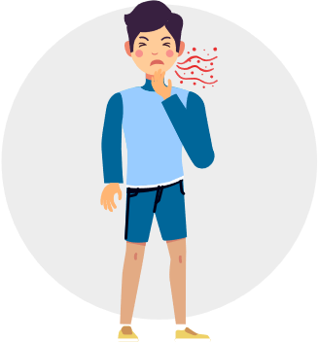
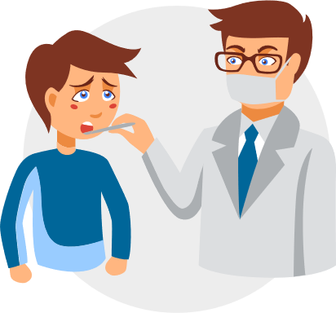





Public Screening Of Suspects @Hospitals
Symptomatic Person
Targets:
Government and private hospitals screening for covid19
Value:
Rapid and cost effective: Biochemical tests are difficult to leverage in hospitals overwhelmed with patients
Highly accurate as the study is processed by AI and is also reviewed and confirmed by a radiologist
Optimized workflow: Swabs for biochemical tests are collected only for AI positive cases Turn Around Time (TAT): AI results are available in a few milli seconds Results with radiologist review in 1 to 2 hours
* Guidelines to the use of X Ray / CT Scan differ from region to region. CT scan is more sensitive than X rays – and can detect a lesion much earlier. However CT scanner have risk of getting contaminated and spread infection. Also CT scanning is considerably more expensive. X Rays are easy to clean and disinfect; also they can be taken to patients' doorstep (portable) and are faster and cost effective. Different countries have issued different guidelines regards the use of X ray / CT scan – primally based on factors like load on the hospital infrastructure, resource availability and risk of contamination and spreading infection. European regions has been using X Rays. While Japan. South Korea have been recommended use of CT scanning.
Clinical Assessment * (Oxygen Saturation Level)
Chest X-Ray
CT Scan
Home with Advice
Hospitalize And Isolate
Self Isolate with follow-up
Hospitalize No Isolation
RT-PCR Test Recommended

Slide 4

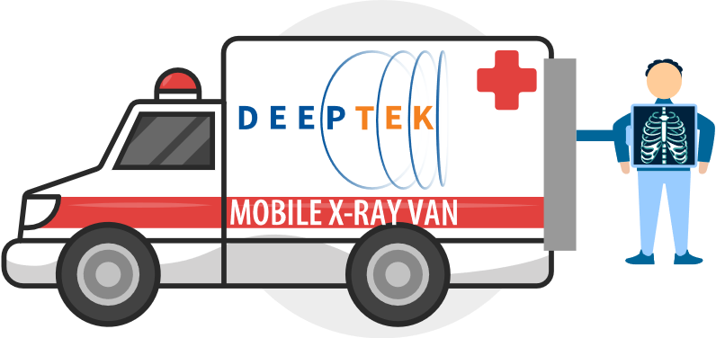
Public Screening Of Suspects @Hot Spots
Symptomatic People
Targets:
Public screening programs in hot spots for symptomatic patients
Value:
Cost effective way of active case finding
Comprehensive Reporting: The report cover all potential findings / impressions – not just COVID19
Highly accurate as the study is processed by AI and is also reviewed and confirmed by a radiologist Turn Around Time (TAT): AI results are available in a few milli seconds Results with radiologist review in 1 to 2 hours
Check Oxygen Saturation
Home with advice
Hospitalize And Isolate
Proposed solution is not recommended for asymptomatic people
Self Isolate with follow-up
Hospitalize No Isolation
RT-PCR Test Recommended

Slide 5
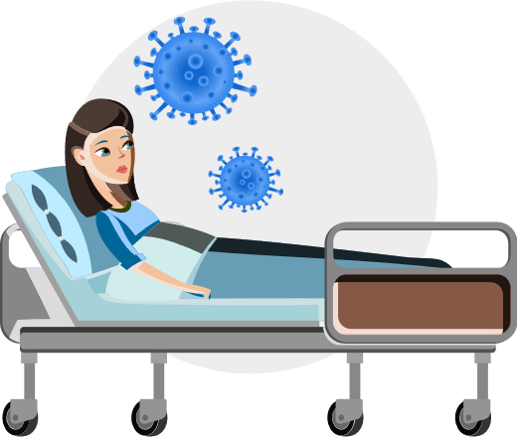


Patient Progress Monitoring
Targets:
Hospitals with Covid19 patients admitted
Screening of self quarantined people
Value:
Rapid and cost effective: Radiologist report with disease progression analysis
Highly accurate as the study is processed by AI and is also reviewed and confirmed by a radiologist
Covid19 Positive Person
Chest X-Ray
Radiology Report
Improving
Turn Around Time (TAT): AI results are available in a few milli seconds Results with radiologist review in 1 to 2 hours
Deteriorating
As Is

Slide 6

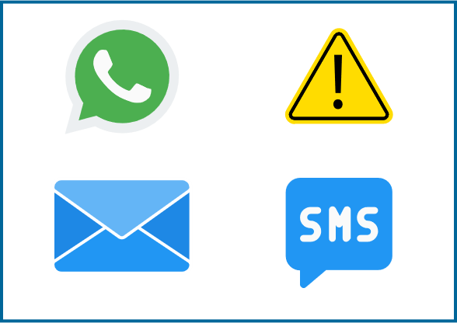
Analytics, Dashboards and Notifications
Targets:
Government Public health departments
Hospitals
Value:
Dashboard and Analytics: Age, Gender, Geolocation, Disease progression analytics easy to understand and actionable
Alert tracking: Radiologist can mark studies are alerts – which results into specialized workflow and better patient care
Notifications and workflow integration: to facilitate easy follow-up and ensure timely care and support to patients
Tailored Solution: Solution will be tailored to the needs of the local requirements
Chest- X-Rays
Dashboards & Analytics
Notification, Alerts &
Workflow integration

Slide 7
Demo

Slide 8
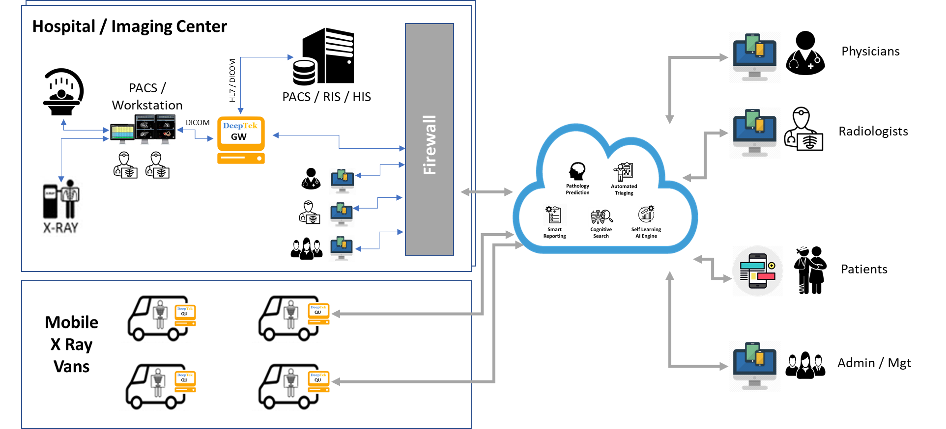
Solution Overview

Slide 9
Over 17 Pathologies covered on the solution
Pleural Thickening
Consolidation
Pneumothorax
Cardiomegaly
Mass
Fibrosis
COVID-19 Pneumonia suspect
Edema
Pneumonia
Effusion
Tuberculosis
Hernia
Foreign
Objects
Atelectasis
Granuloma
Emphysema
Infiltration

Slide 10
AI Accuracy Matrices for Pneumonia Detection
Model as of 15th April 2020
Metric | Description | X-Ray | CT
Sensitivity | Out of all cases with disease, how many were correctly predicted as having disease | 90% | 96%
Specificity | Out of all cases that did not have disease, how many were correctly predicted as not having disease | 95% | 94%
Precision | Out of all cases predicted as having disease, how many actually had disease | 80% | 79%
Accuracy | Percentage of predictions that were correct | 0.94 | 0.94
Though AI model accuracies are high - in real practice – the models are currently being trained only on a small set of data. Also with scans coming from varied sources (different X- Ray markers, settings, pathology manifestations) - these accuracies usually would not hold good. It is important to setup an expert in the loop mechanisms (enabling a feedback loop) to evolve robust AI models which consistently delivery high accuracies in real work practice. DeepTek’s platform enables the same.

Slide 11
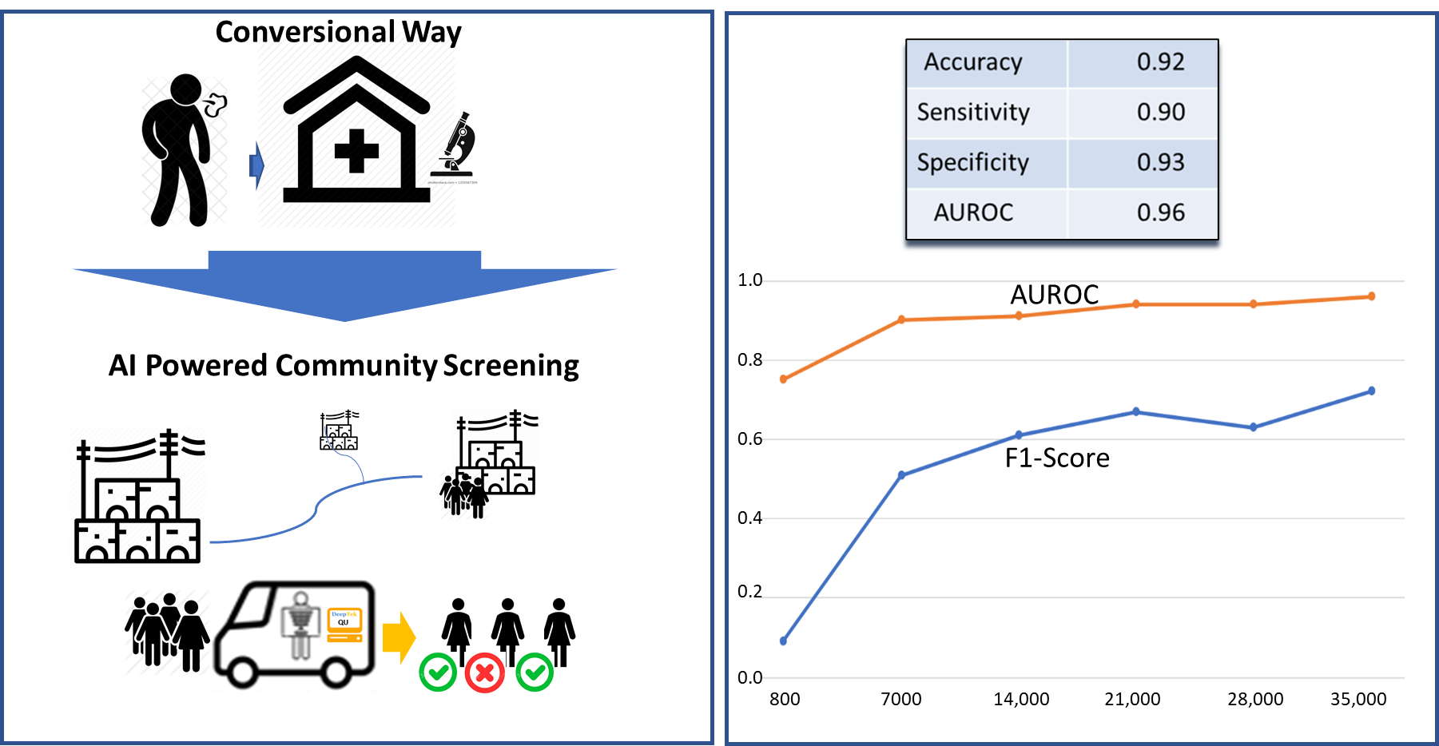
Tuberculosis Case Study: Greater Chennai City Corporation

Slide 12
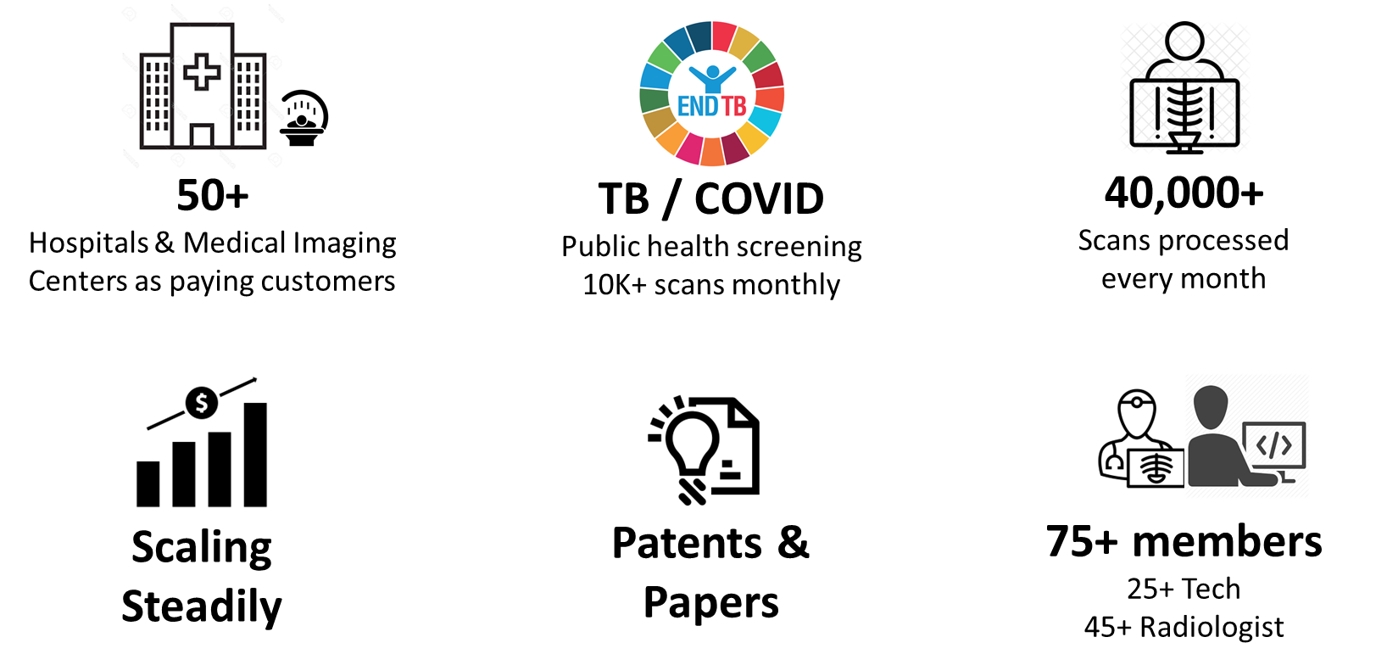
Current Status
AI + Expert In the Loop

Slide 13

DeepTek

Slide 14
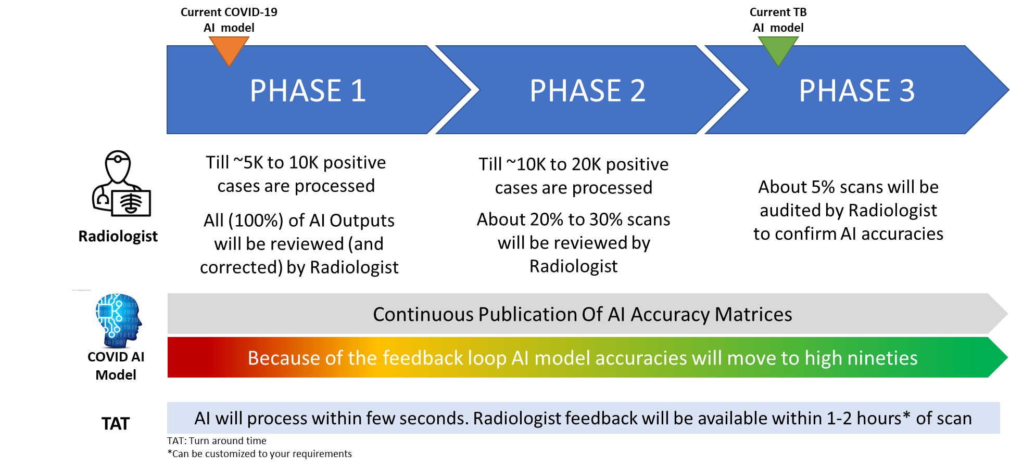
Uncompromised Quality + Continual Improvement

Slide 15
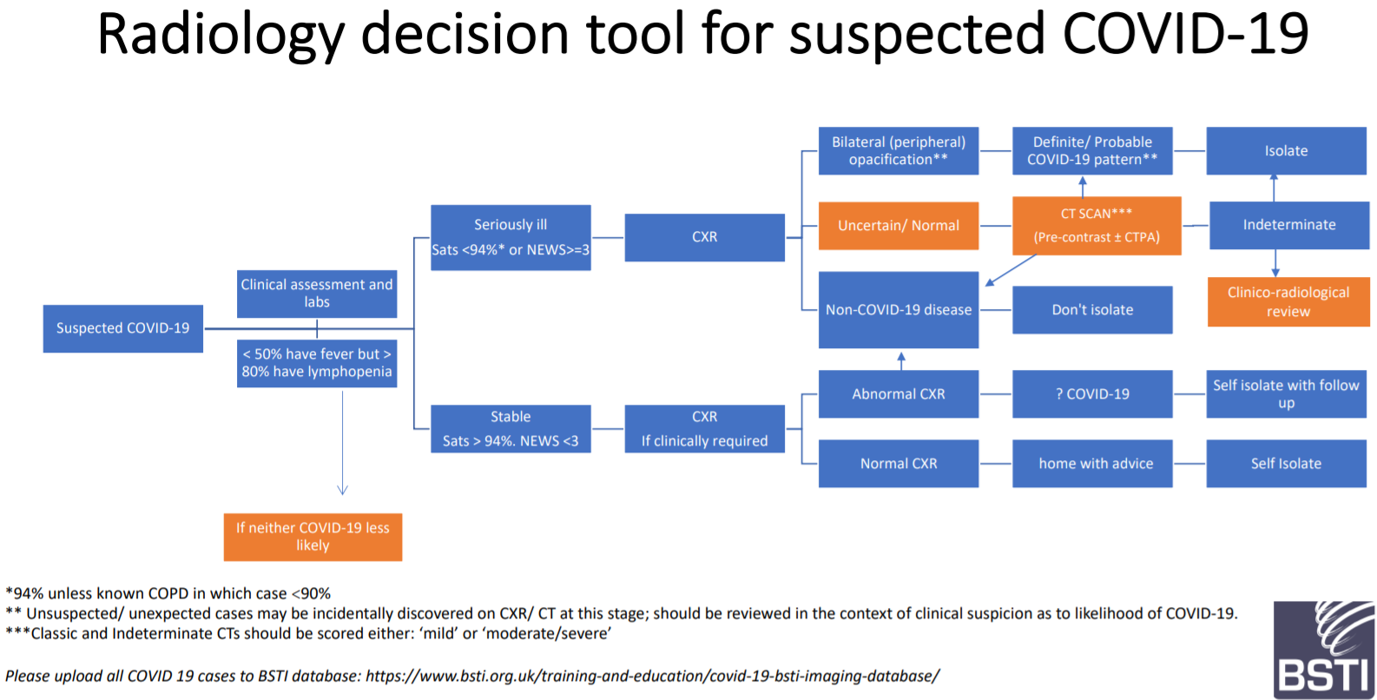
Use of Medical Imaging tools for screening COVID suspects
Guidelines by British Society Of Thoracic Imaging
https://www.bsti.org.uk/media/resources/files/NHSE_BSTI_APPROVED_Radiology_on_CoVid19_v6_modified1__-_Read-Only.pdf

Slide 16

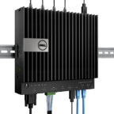
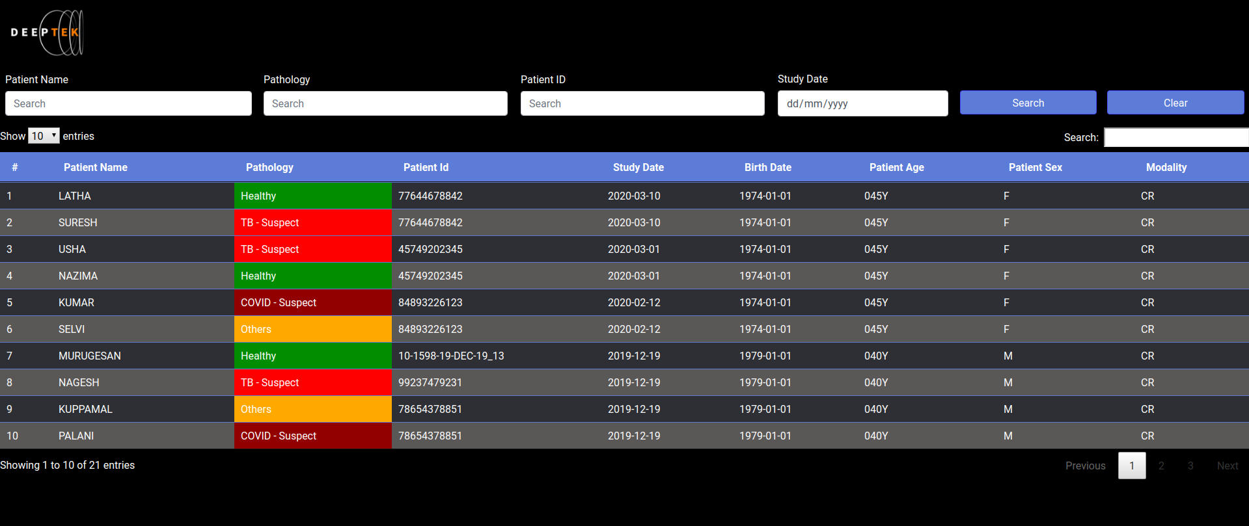
Instantaneous Triaging
Edge Solutions – Triaging positive and normal studies

Slide 17

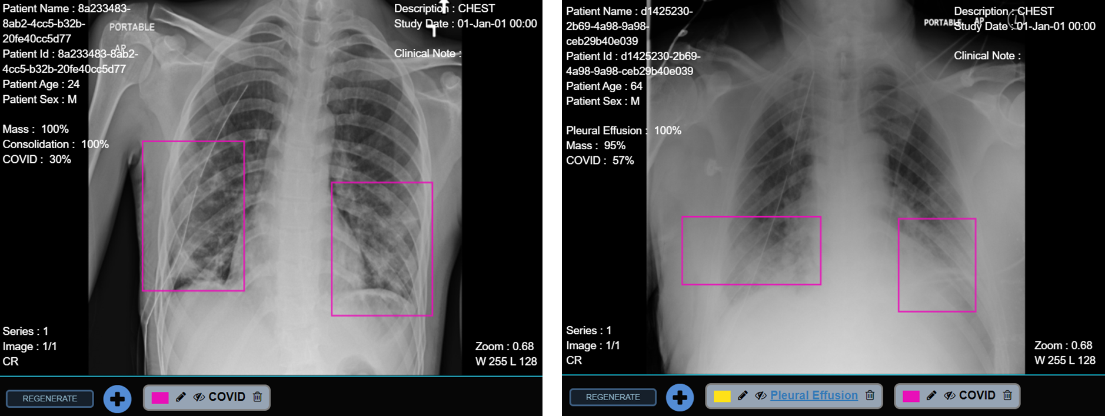
Pathology Prediction

Slide 18

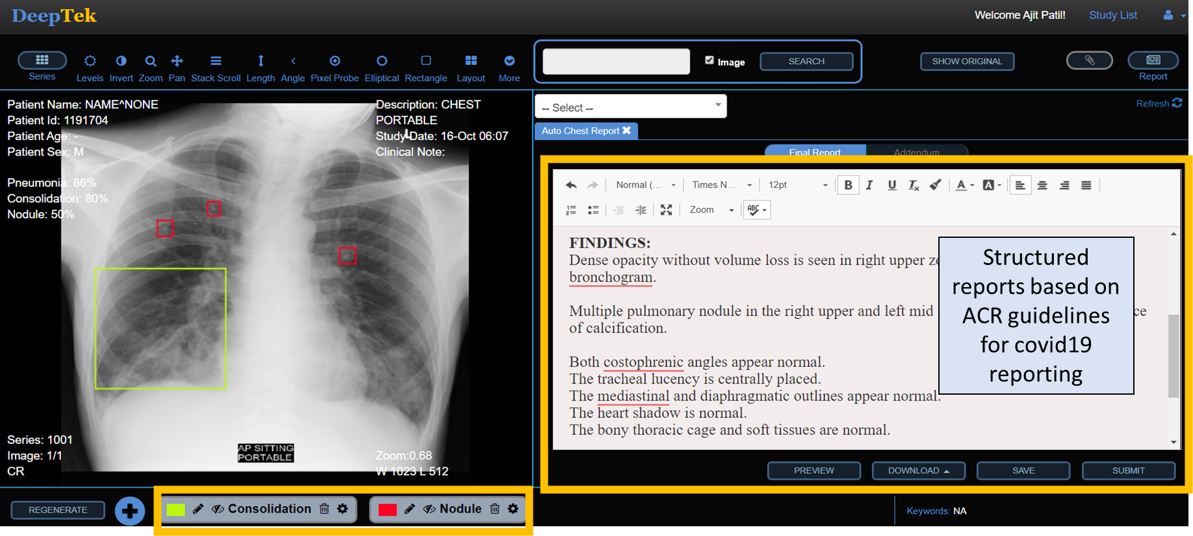
Smart Reporting

Slide 19


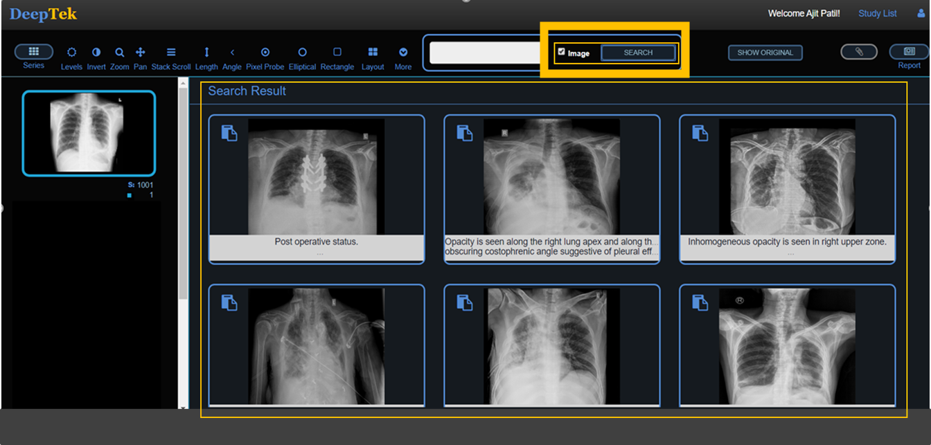
Search Engine

Slide 20

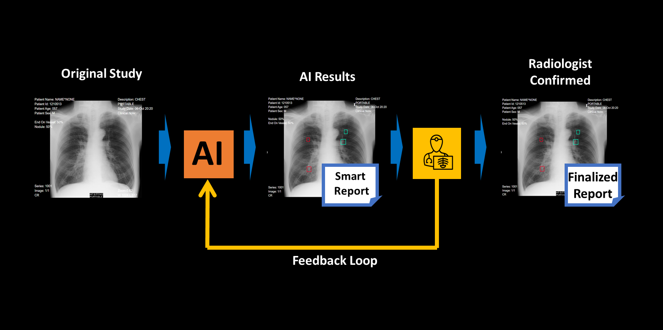
Continual Learning

Slide 21
Identifying potential COVID live infections
For X Rays
Bilateral peripheral opacification
Ground glass opacity
Local patchy shadowing
Bilateral patchy shadowing
Interstitial abnormalities
For CT Scans
Ground glass opacity
Local patchy shadowing
Bilateral patchy shadowing
Interstitial abnormalities
Differentiating between COVID19 and other community acquired Pneumonia is not feasible. Since the classic pattern of chest radiographic findings is seen in a very limited number of patients. Listed patterns help identify potential suspects for further screening
CT scans has high sensitivity for COVID screening. Research has indicated that CT scan can identify potential COVID infection is asymptomatic patients as well

Slide 22
Scope / Limitation
RT-PCR test is the only confirmatory test for COVID (Has variable sensitivity 38% to 73%. So single negative RT-PCR doesn’t exclude COVID-19)
Medical Imaging based techniques are only auxiliary tools for screening of patients in absence of RT-PCR tests.
Additional clinical assessment data should also be leveraged
Fever / Temperature assessment
Simple Blood Count (Neutrophilia and Lymphopenia)
Oxygen Saturation in blood
Clinical assessment data along with medical imaging findings can support decision making to advice
Home with Advice
Self Isolate with follow-up
Hospitalize - No Isolation
Hospitalize And Isolate

